Slide 1
Residency Trainer? Clerkship Instructor? Didactic Lecturer?
Yes, you and your students will benefit from formative assessment!
Learn How.

Slide 2
Presented By
Dawn Ballard
dawn.ballard@okstate.edu
And
Dan Thompson
dan.thompson@okstate.edu

Slide 3
Session objectives
At the end of this session, participants will be able to:
Define formative assessment
Recognize purposes of using formative assessment
Identify when to use formative assessment
Create formative assessment in their program

Slide 4
Definition
Formative Assessment is defined as “information communicated to the learner that is intended to modify his or her thinking or behavior for the purpose of improving learning” (Shute, 2008, pg. 154).
Generally low stakes, which means that they have low or no point value
It is part of a feedback process in which a learner is able to evaluate their response in light of the information received, and make adjustments.

Slide 5
Why use formative assessment?
Formative assessment can be directly integrated into the course or unit, and specifically tied to the learning objectives.
Identify gaps in knowledge
Help novice learners to identify important information
Connect procedural errors or misconceptions
Research proves students perform better on summative exams (boards, end of rotation exams, etc) when formative assessment is used during the teaching process.

Slide 6
Why use formative assessment?
Accreditation…we have to prove not only that we are teaching specific content, but also that students are learning it…how else can we prove that?
It can be standardized through multiple clinics in the same rotation
Students can self assess

Slide 7
Feedback
Formative assessment is designed to provide feedback at multiple levels. First, it provides feedback to the educator about current levels of student understanding.
This feedback also informs what the next steps in learning should be.
For the learner, this feedback indicates how their understanding differs from the desired learning goal and how they can move forward.

Slide 8
When to use formative assessment
Most educators realize that good teaching involves interaction, which is a prerequisite to formative assessment
Let students know what direction you want to go in by creating clear criteria or performance standards in which student progress will be assessed
Educators should be aware of students’ performance on the assessment and then modify their teaching by addressing knowledge and comprehensive deficits

Slide 9
Great, now give me examples!

Slide 10
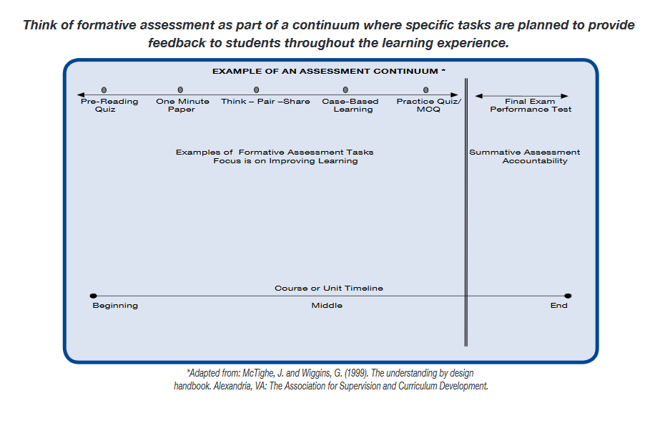

Slide 11
Quizzes
Thought about a pre-class quiz?
Students are tested after a learning session to guide further studying. They work best with response specific feedback.
Can be done online with ExamSoft
Embed questions in pre-recorded videos (Panopto)
Nearpod
TrueLearn

Slide 12
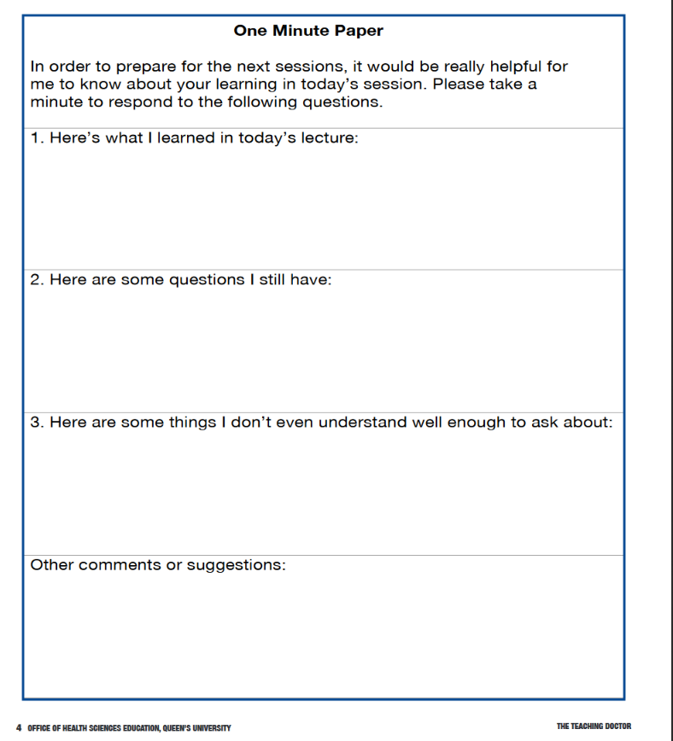

Slide 13
Think--Pair--Share
Pose a question to the group. Give students a minute to jot down some points individually. Have the students turn to the person next to them and discuss their response.
In fours or sixes this is where the real work gets done. This actually allows the students to self-assess and get feedback from their peers regarding progress against learning goals.
The instructor is left free to observe, reflect and provide helpful interactions.

Slide 14
Case-Based Learning
A case is presented, student can work in groups or individually to interpret and arrive at a response or diagnosis on their own.

Slide 15
References
Bell B., & Cowie, B. (2001). The characteristics of formative assessment in science education. Science Education, 85(5), 536–553.
McTighe, J. & Wiggins, G. (1999). The Understanding by design handbook. Alexander, VA: The Association for Supervision and Curriculum Development.
Shute, V. (2008). Focus on Formative Feedback. Review of Education. Research. 78 (1), 154-189

